Slide 1
Day 05

Slide 2
GMM

Slide 3
Gaussian mixture model
GMMs have been used for feature extraction from speech data, and have also been used extensively in object tracking of multiple objects, where the number of mixture components and their means predict object locations at each frame in a video sequence.
For example, in modeling human height data, height is typically modeled as a normal distribution for each gender with a mean of approximately 5'10" for males and 5'5" for females. Given only the height data and not the gender assignments for each data point, the distribution of all heights would follow the sum of two scaled (different variance) and shifted (different mean) normal distributions. A model making this assumption is an example of a Gaussian mixture model (GMM), though in general a GMM may have more than two components. Estimating the parameters of the individual normal distribution components is a canonical problem in modeling data with GMMs.

Slide 4
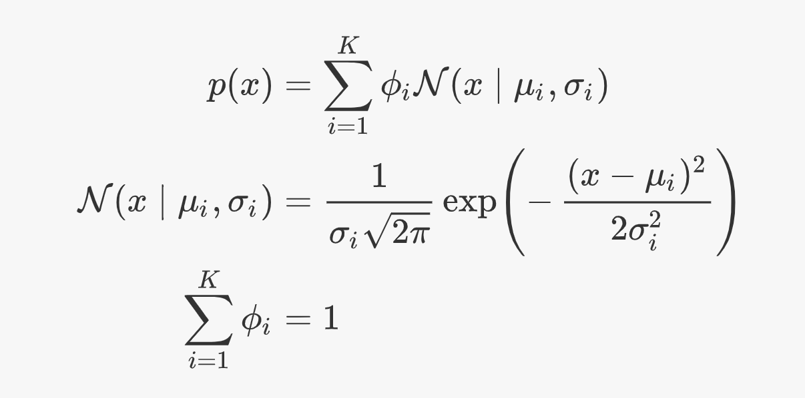
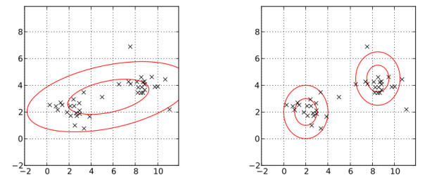
Multimodal

Slide 5
EM for Gaussian Mixture Models
EM for Gaussian Mixture Models
The first step, known as the expectation step or E step, consists of calculating the expectation of the component assignments for each data point given the model parameters , , and .
The second step is known as the maximization step or M step, which consists of maximizing the expectations calculated in the E step with respect to the model parameters. This step consists of updating the values , , and .
https://brilliant.org/wiki/gaussian-mixture-model/
The EM algorithm updating the parameters of a two-component bivariate Gaussian mixture model.

Slide 6
Other approaches
https://scikit-learn.org/stable/modules/mixture.html
Variational Bayesian Gaussian Mixture
GMMs are flexible approximators of density functions (not for general functions --> in this case you need to look at the very similar concept of Gaussian radial basis function networks; but these have no normalization constraints as in densities). The question is not if the density that you would like to model with a GMM originally stems from a GMM. It is more a question of how accurate you want to model it by using a general modeling tool like GMMs. The more components you use, the more accurate your approximation will usually be. There are also concepts to automatically learn the number of components: See e.g. "The Variational Approximation for Bayesian Inference" by Dimitris G. Tzikas et al.
https://www.researchgate.net/post/If_I_have_a_dataset_how_can_I_prove_that_this_dataset_has_a_nature_of_Gaussian_Mixture_Model_GMM

Slide 7
see also Ch3_IntroMCMC_PyMC3.ipynb
notebook working on mixture data

